Slide 1

SC1015
MINI-PROJECT
Group 7 Members: Kar Kit, Aliff and Nicholas

Slide 2



EVENT FLOW
PROBLEM FORMULATION
EXPLORATORY DATA ANALYSIS
DATA PREPARATION & CLEANING
MACHINE LEARNING
DATA DRIVEN INSIGHTS
CONCLUSION

Slide 3

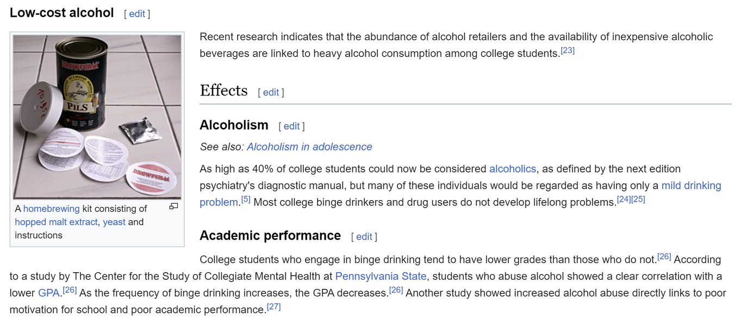
CONTEXT
Approximately 80% of college students reportedly have engaged in the consumption of alcohol.
Mostly due to peer pressure, stress and societal influence
Alcoholism affects academic performance, health etc

Slide 4
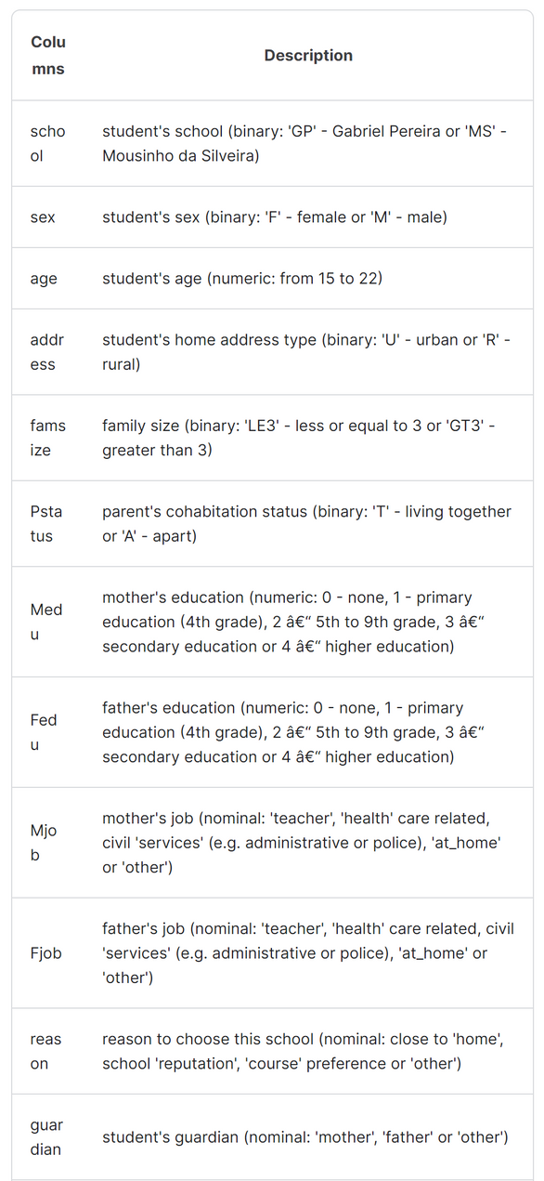
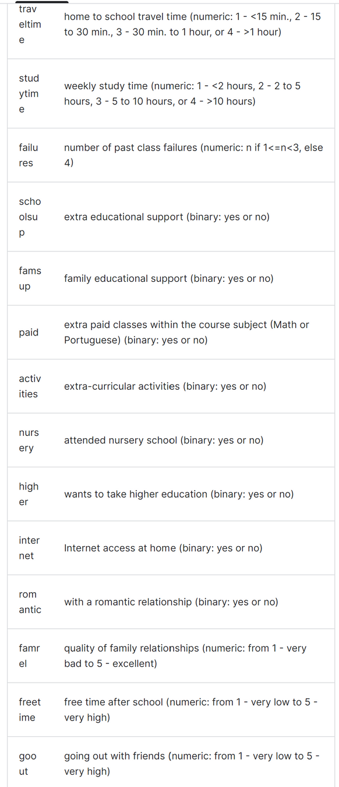
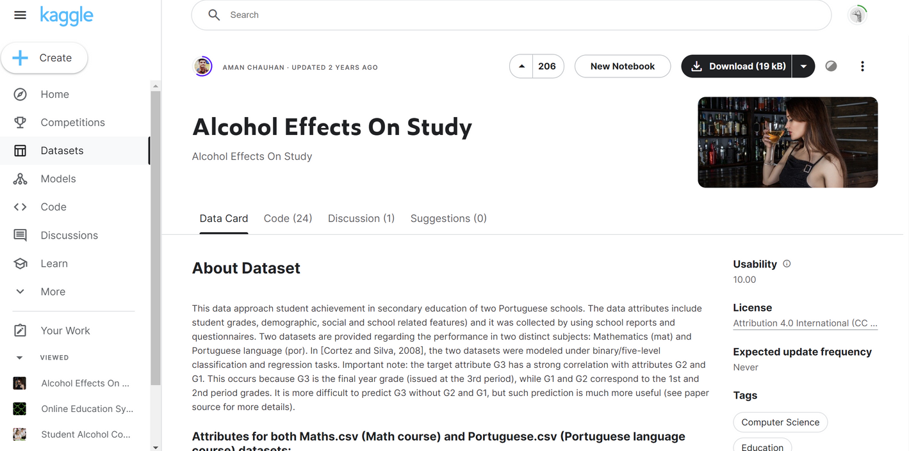
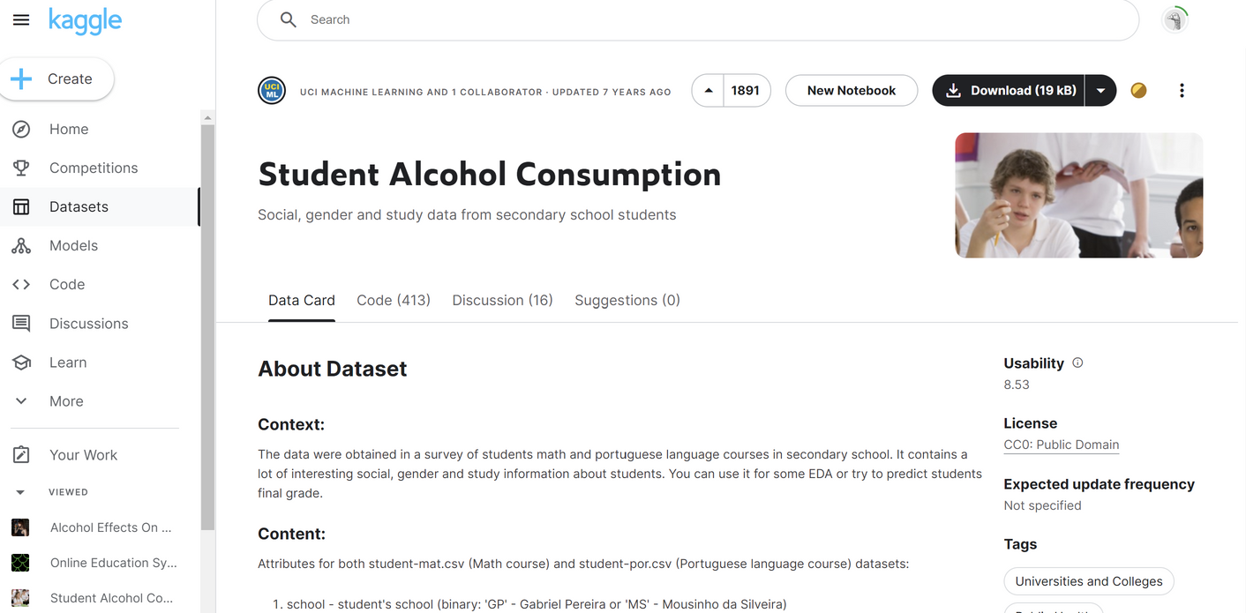
DATASET USED:

Slide 5


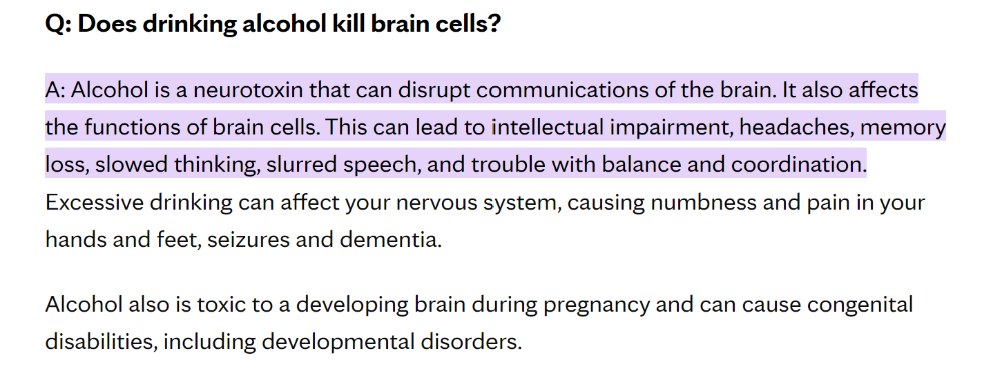
PROBLEM FORMULATION:
WE FOUND OUT THAT ALCOHOL AFFECTS THE FUNCTIONALITY IN THE BRAIN
AFFECTING STUDENT’S PERFORMANCE
REF: HTTPS://WWW.MAYOCLINICHEALTHSYSTEM.ORG/HOMETOWN-HEALTH/SPEAKING-OF-HEALTH/DOES-DRINKING-ALCOHOL-KILL-BRAIN-CELLS#:~:TEXT=A%3A%20ALCOHOL%20IS%20A%20NEUROTOXIN,TROUBLE%20WITH%20BALANCE%20AND%20COORDINATION.

Slide 6
PROBLEM FORMULATION:
WHICH WE WANT TO FIND:
DOES ALC0HOL CONSUMPTION AFFECTS STUDENT’S PERFORMANCE?

Slide 7

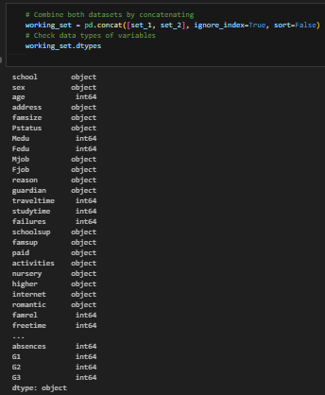
EXPLORATORY DATA ANALYSIS
Data contains both numerical and categorical variables
Separated them and work on numerical and categorical variable separately to better identify the relations
Able to identify if other numerical variables has a relation to grades

Slide 8
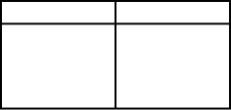
EXPLORATORY DATA ANALYSIS
Numerical Variables
Categorical Variables
age
Medu
Fedu
traveltime
studytime
failures
famrel
goout
Dalc
Walc
health
absence
G1
G2
G3
school
sex
address
famsize
Pstatus
Mjob
Fjob
reason
guardian
schoolsup
famsup
paid
activities
nursery
higher
internet
romantic

Slide 9
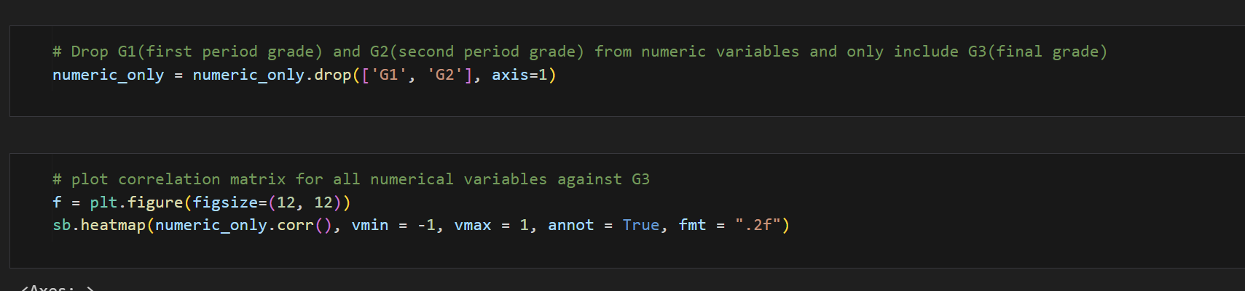
EXPLORATORY DATA ANALYSIS
Numerical Variables
Correlation matrix to see mainly to see the relation between Dalc (WeekDay Alcohol Intake, Walc (WeekEnd Alcohol Intake) with grades (G1, G2, G3).
Able to look for other numerical variables that affects grades as well.

Slide 10
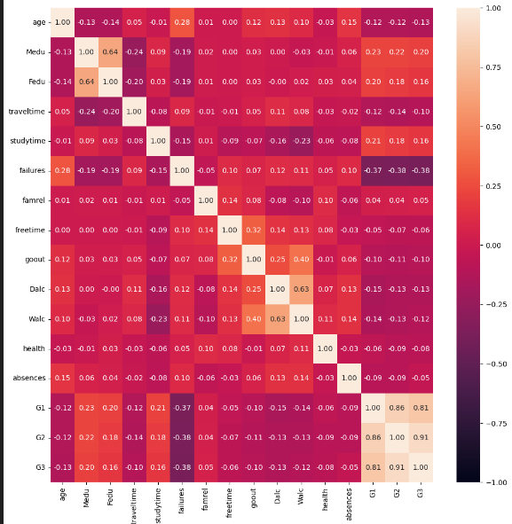
EXPLORATORY DATA ANALYSIS
Numerical Variables
We see that G1, G2, and G3 seems to be highly correlate to one another.
Dalc, Walc against grades seems to have low negative correlation
Other factors like age, parent education etc also have low correlation value with G3
This indicates that alcohol consumption does not necessarily affect academic performance of a student

Slide 11
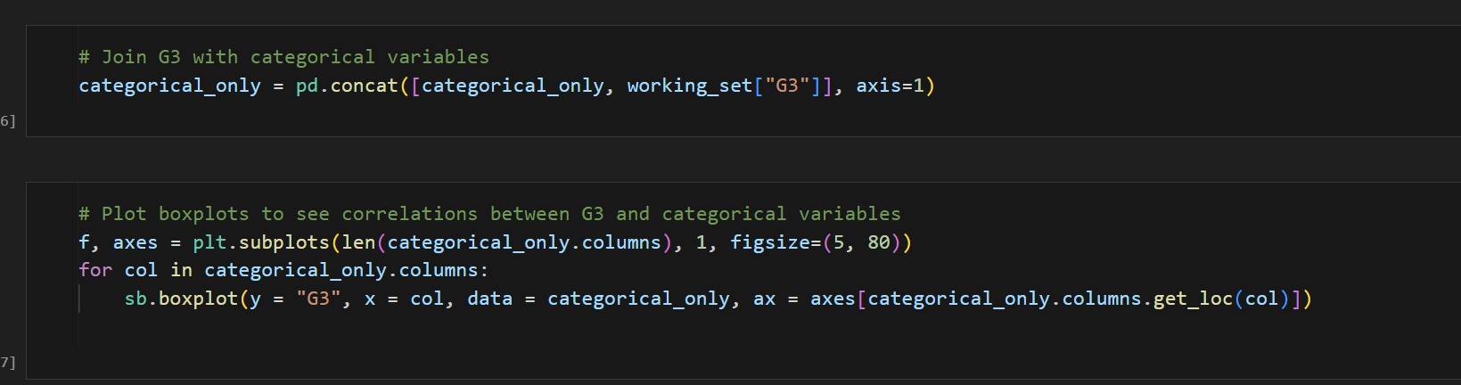
EXPLORATORY DATA ANALYSIS
Categorical Variables
Utilized boxplot to look for potential relations between G3 and categorical variables

Slide 12
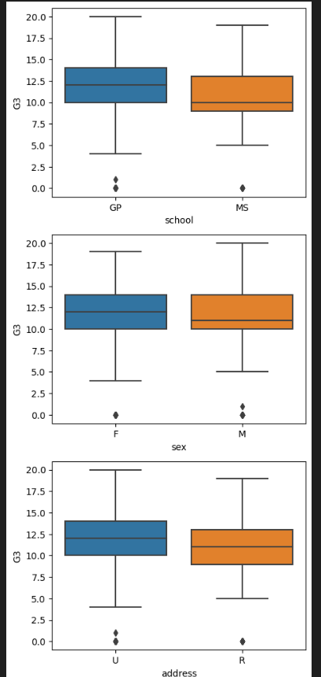
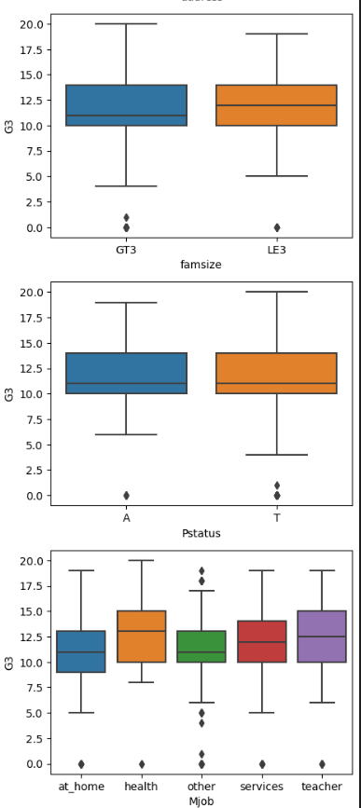
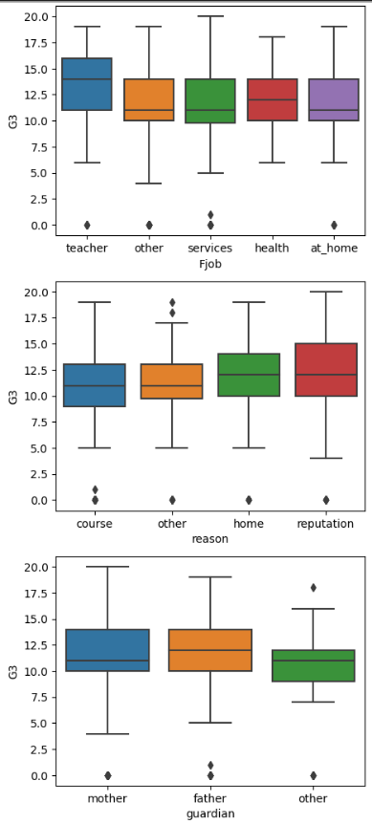
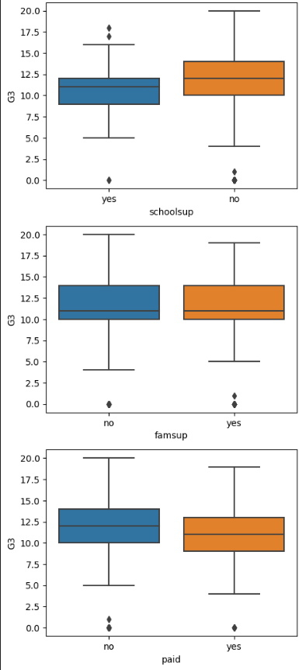
EXPLORATORY DATA ANALYSIS
Categorical Variables

Slide 13
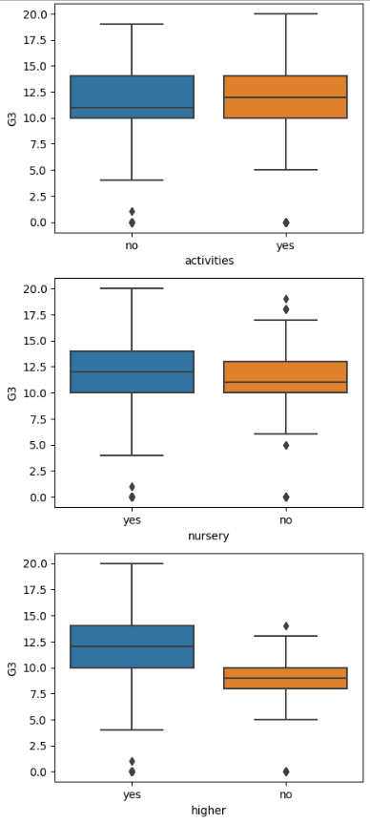
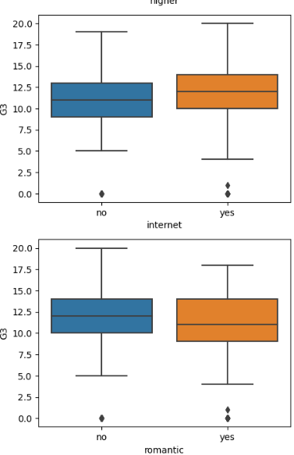
EXPLORATORY DATA ANALYSIS
Categorical Variables
We notice based on the boxplots that variables:
Mjob (Mother’s Job)
Fjob(Father’s Job)
reason(reason for enrolling in school)
higher(decision to take higher education
They have potential correlations with their grades G3 in this case.

Slide 14
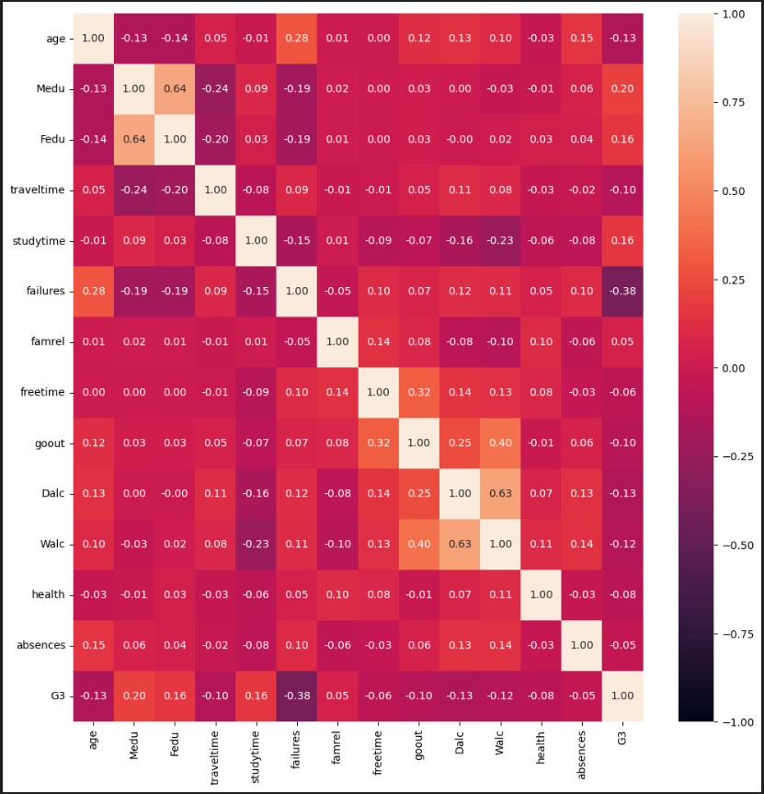
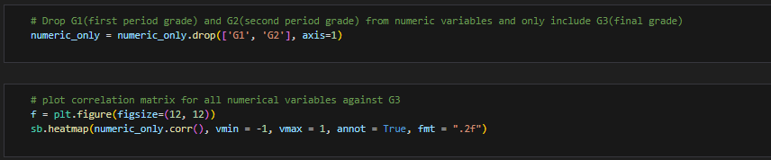
DATA PREPARATION AND CLEANING
G1 and G2 is an indicative of their final grade (G3) since they are highly correlated to one another
Hence, it is deemed unnecessary to look at the correlation between G1 and G2 against other numerical values
Hence, we only consider G3

Slide 15
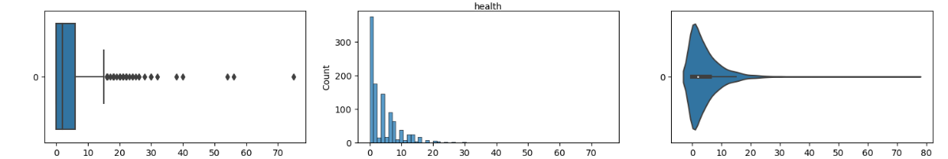
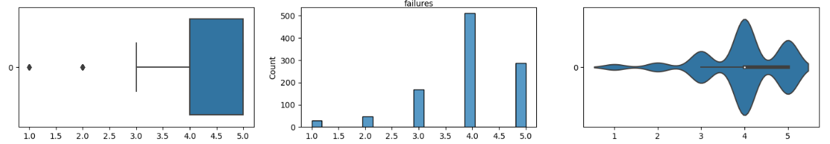
DATA PREPARATION AND CLEANING
Some variables had several outliers
Need to remove outliers
Some variables were very skewed
Need to correct based on whether its positive or negative skewness

Slide 16
DATA PREPARATION AND CLEANING
 | age | Medu | Fedu | traveltime | studytime | failures | famrel | freetime | goout | Dalc | Walc | health | absences | G3
count | 1044.000000 | 1044.000000 | 1044.000000 | 1044.000000 | 1044.000000 | 1044.0 | 1044.000000 | 1044.000000 | 1044.000000 | 1044.000000 | 1044.000000 | 1044.000000 | 1044.000000 | 1044.000000
mean | 16.715931 | 2.603448 | 2.387931 | 1.464706 | 1.842159 | 0.0 | 4.120993 | 3.344898 | 3.156130 | 1.336694 | 2.284483 | 3.543103 | 3.428283 | 11.959596
std | 1.218236 | 1.124907 | 1.099938 | 0.625236 | 0.660148 | 0.0 | 0.650130 | 0.864460 | 1.152575 | 0.587130 | 1.285105 | 1.424703 | 3.689326 | 2.816944
min | 15.000000 | 0.000000 | 0.000000 | 1.000000 | 1.000000 | 0.0 | 3.000000 | 2.000000 | 1.000000 | 1.000000 | 1.000000 | 1.000000 | 0.000000 | 4.000000
25% | 16.000000 | 2.000000 | 1.000000 | 1.000000 | 1.000000 | 0.0 | 4.000000 | 3.000000 | 2.000000 | 1.000000 | 1.000000 | 3.000000 | 0.000000 | 10.000000
50% | 17.000000 | 3.000000 | 2.000000 | 1.000000 | 2.000000 | 0.0 | 4.000000 | 3.000000 | 3.000000 | 1.000000 | 2.000000 | 4.000000 | 2.000000 | 11.959596
75% | 18.000000 | 4.000000 | 3.000000 | 2.000000 | 2.000000 | 0.0 | 5.000000 | 4.000000 | 4.000000 | 2.000000 | 3.000000 | 5.000000 | 6.000000 | 14.000000
max | 21.000000 | 4.000000 | 4.000000 | 3.000000 | 3.000000 | 0.0 | 5.000000 | 5.000000 | 5.000000 | 3.000000 | 5.000000 | 5.000000 | 15.000000 | 20.000000
Describe data after removing outliers
There are no failures after outliers removed
No need to consider failures in our models

Slide 17
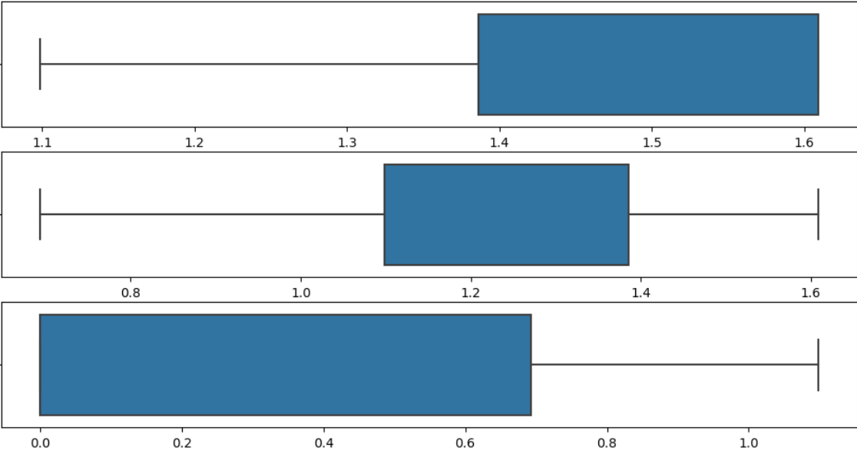
DATA PREPARATION AND CLEANING
Correcting positive skewness
Applied logarithm transformation
Data still skewed
Log transformation did not correct skewness
Skewed data were one hot-encoded data by creator
e.g. famrel is represented on a scale of 1 to 5
Skewness could not be corrected this way

Slide 18
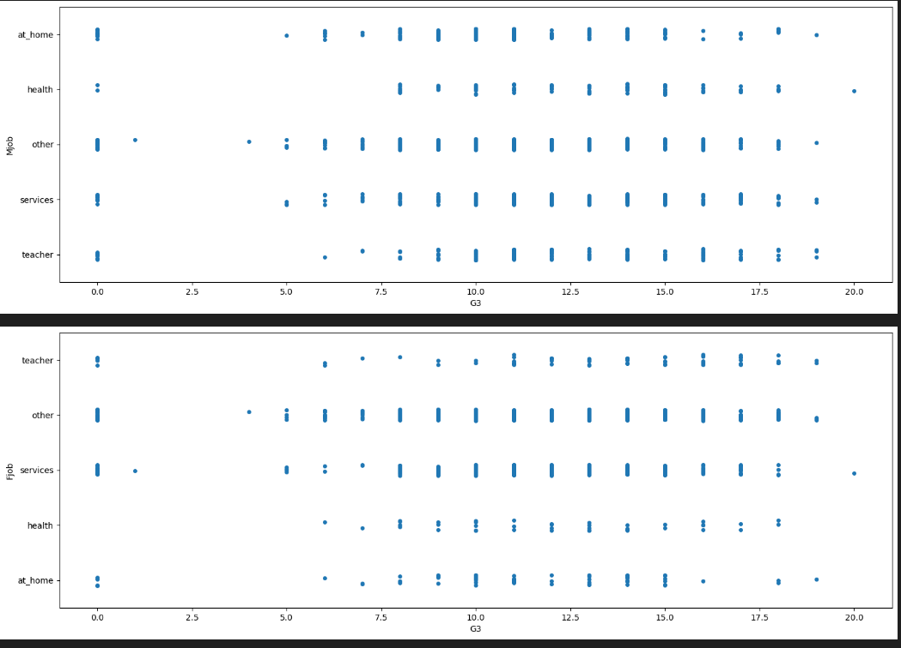
DATA PREPARATION AND CLEANING
Since only variables:
Mjob
Fjob
reason
higher
Have potential correlations with G3
We extract these variables and put them in a strip plot to narrow down the relations

Slide 19
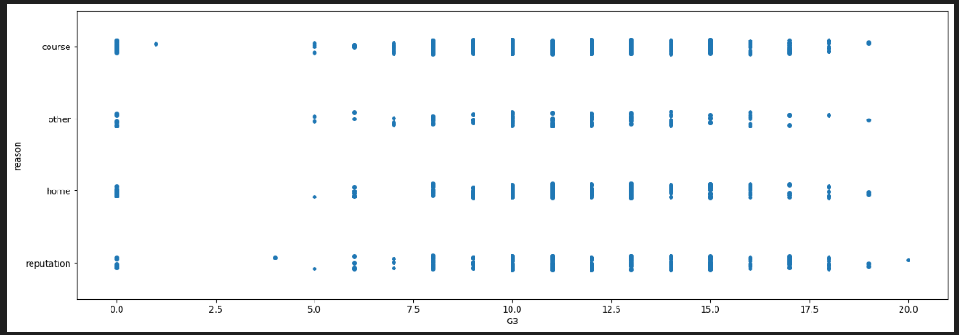
DATA PREPARATION AND CLEANING

Slide 20
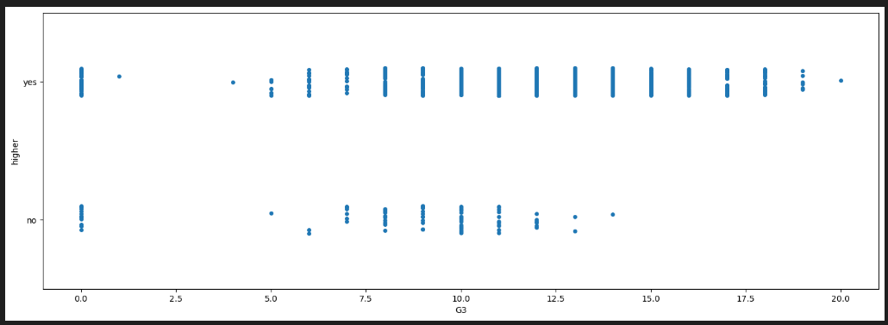
DATA PREPARATION AND CLEANING
Based on the strip plot, only the variable ‘higher’ has a correlation with G3.

Slide 21

FINAL DATA TO BE USED
Numerical Variables
Categorical Variables
higher (decision to pursue higher education)
age
Medu
Fedu
traveltime
studytime
famrel
goout
Dalc
Walc
health
absence
G3

Slide 22
MACHINE LEARNING:
Techniques used:
LASSO REGRESSION
ON MULTIPLE NUMERICAL VARIABLES
NEURAL NETWORK EMBEDDING
ON CATEGORICAL VARIABLES

Slide 23
LASSO REGRESSION
Regression method that performs feature selection
Selects optimal combination of coefficients and variables for regression model
Does L1 regularization which can potentially correct skewness

Slide 24
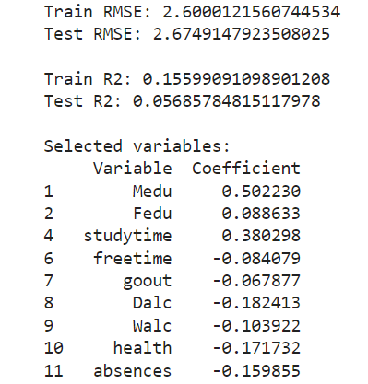
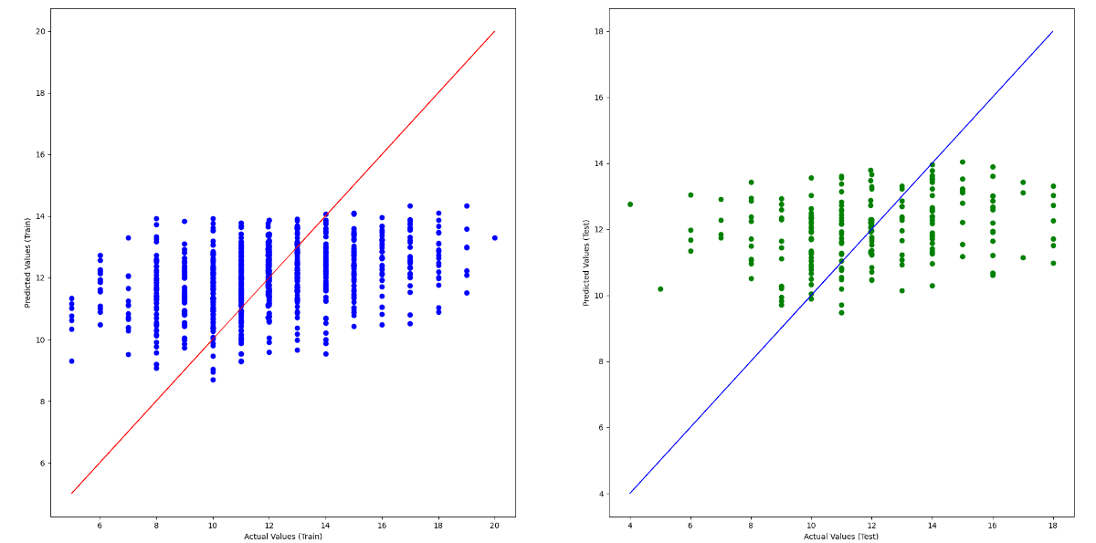
LASSO REGRESSION
Results

Slide 25
NEURAL NETWORK EMBEDDING
Can handle predicting numerical variable using categorical variables
Represents categorical values as continuous vectors
Embeddings learned during training of neural network
We only used “higher” variable to test against G3

Slide 26
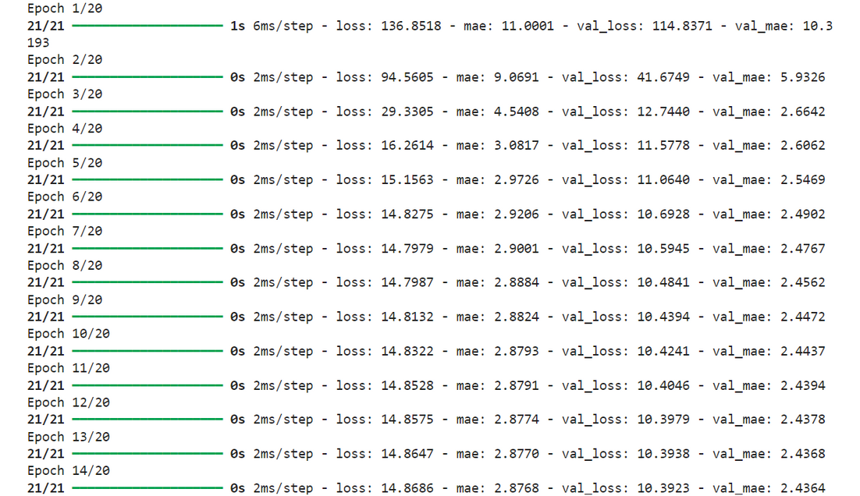
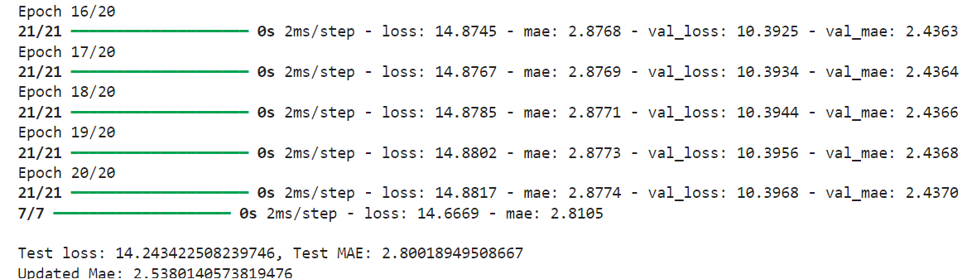
NEURAL NETWORK EMBEDDING
Results:
20 epochs
Training data is passed into algorithm 20 times
First 2 epochs outliers
Mean Absolute Error
2.8
2.5 (without outliers)

Slide 27
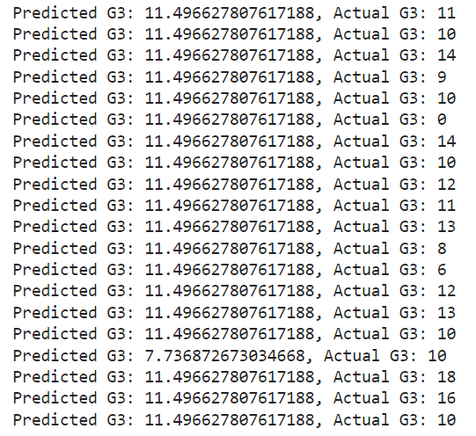
NEURAL NETWORK EMBEDDING
Predictions:
Mean G3 is 11.96
Mean error percentage of 20%
Prediction can be somewhat accurate from results
But error margin still too large

Slide 28

DATA DRIVEN INSIGHTS & RECOMMENDATION
Alcohol Consumption Not a Prime Predictor
Academic performance isn't primarily determined by a student's alcohol consumption levels.
Lasso Regression Model Limitations
Even with multiple variables considered, the Lasso Regression model could not accurately predict final grades.
Indicates that environment and habits do not solely determine academic success.
High Correlation with Plans for Higher Education
The strongest predictor of academic performance is the student's intention to pursue higher education.
Motivation to meet higher education requirements likely enhances performance.
Individual Differences Impact Academic Results
Each student's unique characteristics make it challenging to standardize a prediction model for academic performance.
Variables affect students differently, complicating the prediction of academic success.

Slide 29

CONCLUSION
Based on our findings,
Alcoholism might NOT affect
Student’s performance

Slide 30

THANK YOU

Slide 31
Reference:
Mayo Clinic Health System. (n.d.). Does drinking alcohol kill brain cells? Mayo Clinic Health System. Retrieved April 19, 2024, from Add a little bit of Reference: Mayo Clinic Health System. (n.d.). Does drinking alcohol kill brain cells? Mayo Clinic Health System. Retrieved April 19, 2024, from body text
Wikipedia contributors. (n.d.). Alcohol use among college students. In Wikipedia, The Free Encyclopedia. Retrieved April 19, 2024, from https://en.wikipedia.org/wiki/Alcohol_use_among_college_students

